Slide 1

Data 201 Capstone
Erik Rigby

Slide 2
Data 201 Capstone
The focus is on Identity Theft in New York City using historical NYPD data from 2006 to April 2023. Does this data align with the Federal Trade Commission’s (“FTC”) national or metropolitan regional average?
The dataset is 5.5 million rows and 19 columns.
My interest is two-fold; I am a Certified Fraud Examiner (“CFE”) and I have had to file my own fraud claims, specifically, in the summer of 2020, when someone filed a fraudulent unemployment claim in my name.

Slide 3
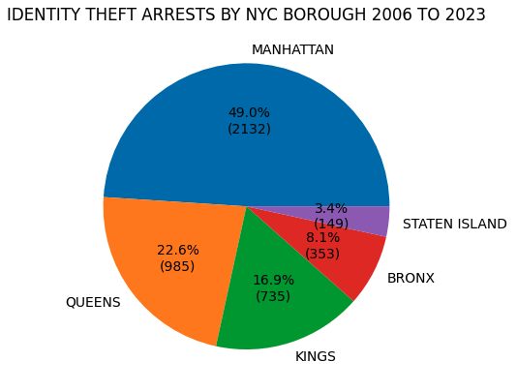
Primary findings
Almost half of the Identity Theft Arrests in New York City occurred in the Borough of Manhattan.
Black males were arrested at a rate of almost three times that of other races.
While other arrest categories continued to be reported by the NYPD through April 2023, Identity Theft no longer appeared after December 2018.

Slide 4
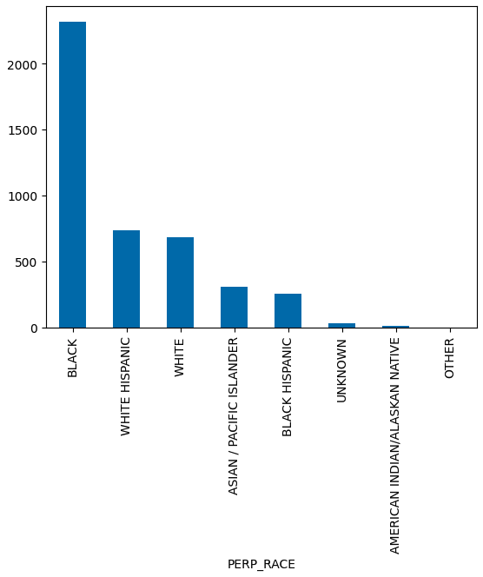
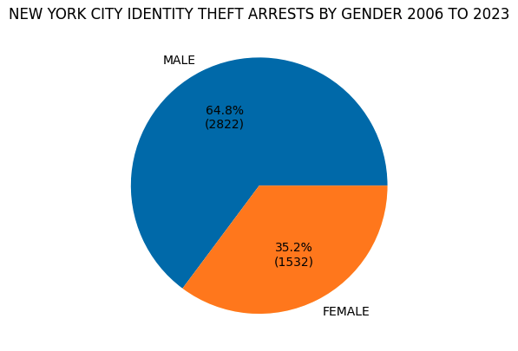
NYC identity theft Arrests by race and gender

Slide 5
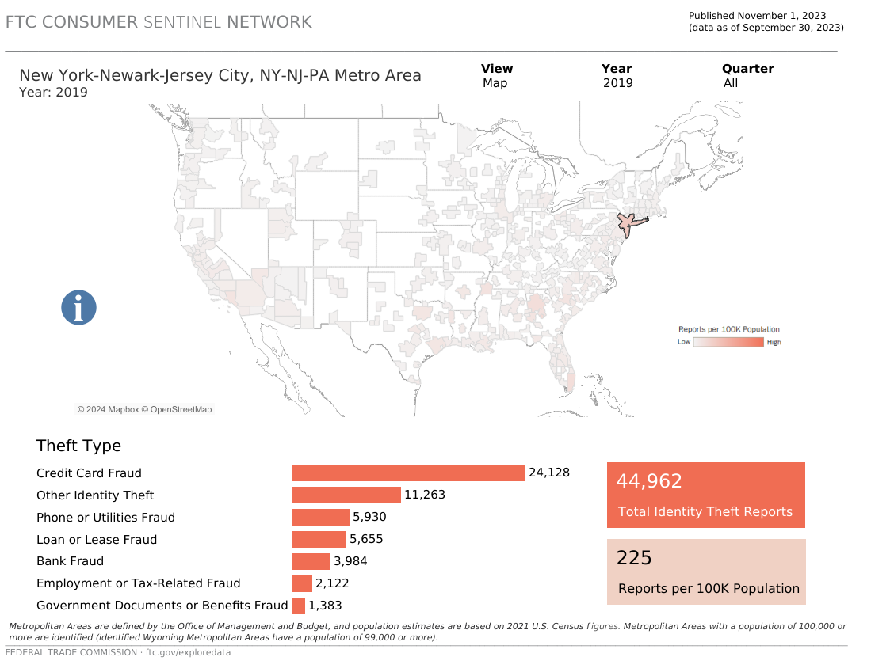
FTC 2019 NY Metro ID Theft average 225/100k

Slide 6
Summary
NYPD Identity Theft reporting ended in 2018 and did not mirror what was being reported by the FTC. The data appeared flawed or was captured elsewhere.
Libraries: Pandas, NumPy, Matplotlib
Data Cleaning: Dropped unnecessary column; Replaced null/NaN data; Assigned DateTime value to column
Wrangling: New data frames; Renamed column headers; Filtered by string contains
Visualizations: Bar and Pie Charts

Slide 7
References
https://data.cityofnewyork.us/Public-Safety/NYPD-Arrests-Data-Historic-/8h9b-rp9u
https://public.tableau.com/app/profile/federal.trade.commission/viz/FraudandIDTheftMaps/FraudbyMetroArea
https://www.ic3.gov/Media/PDF/AnnualReport/2022_IC3Report.pdf
https://identitytheft.org/statistics/

